Slide 1
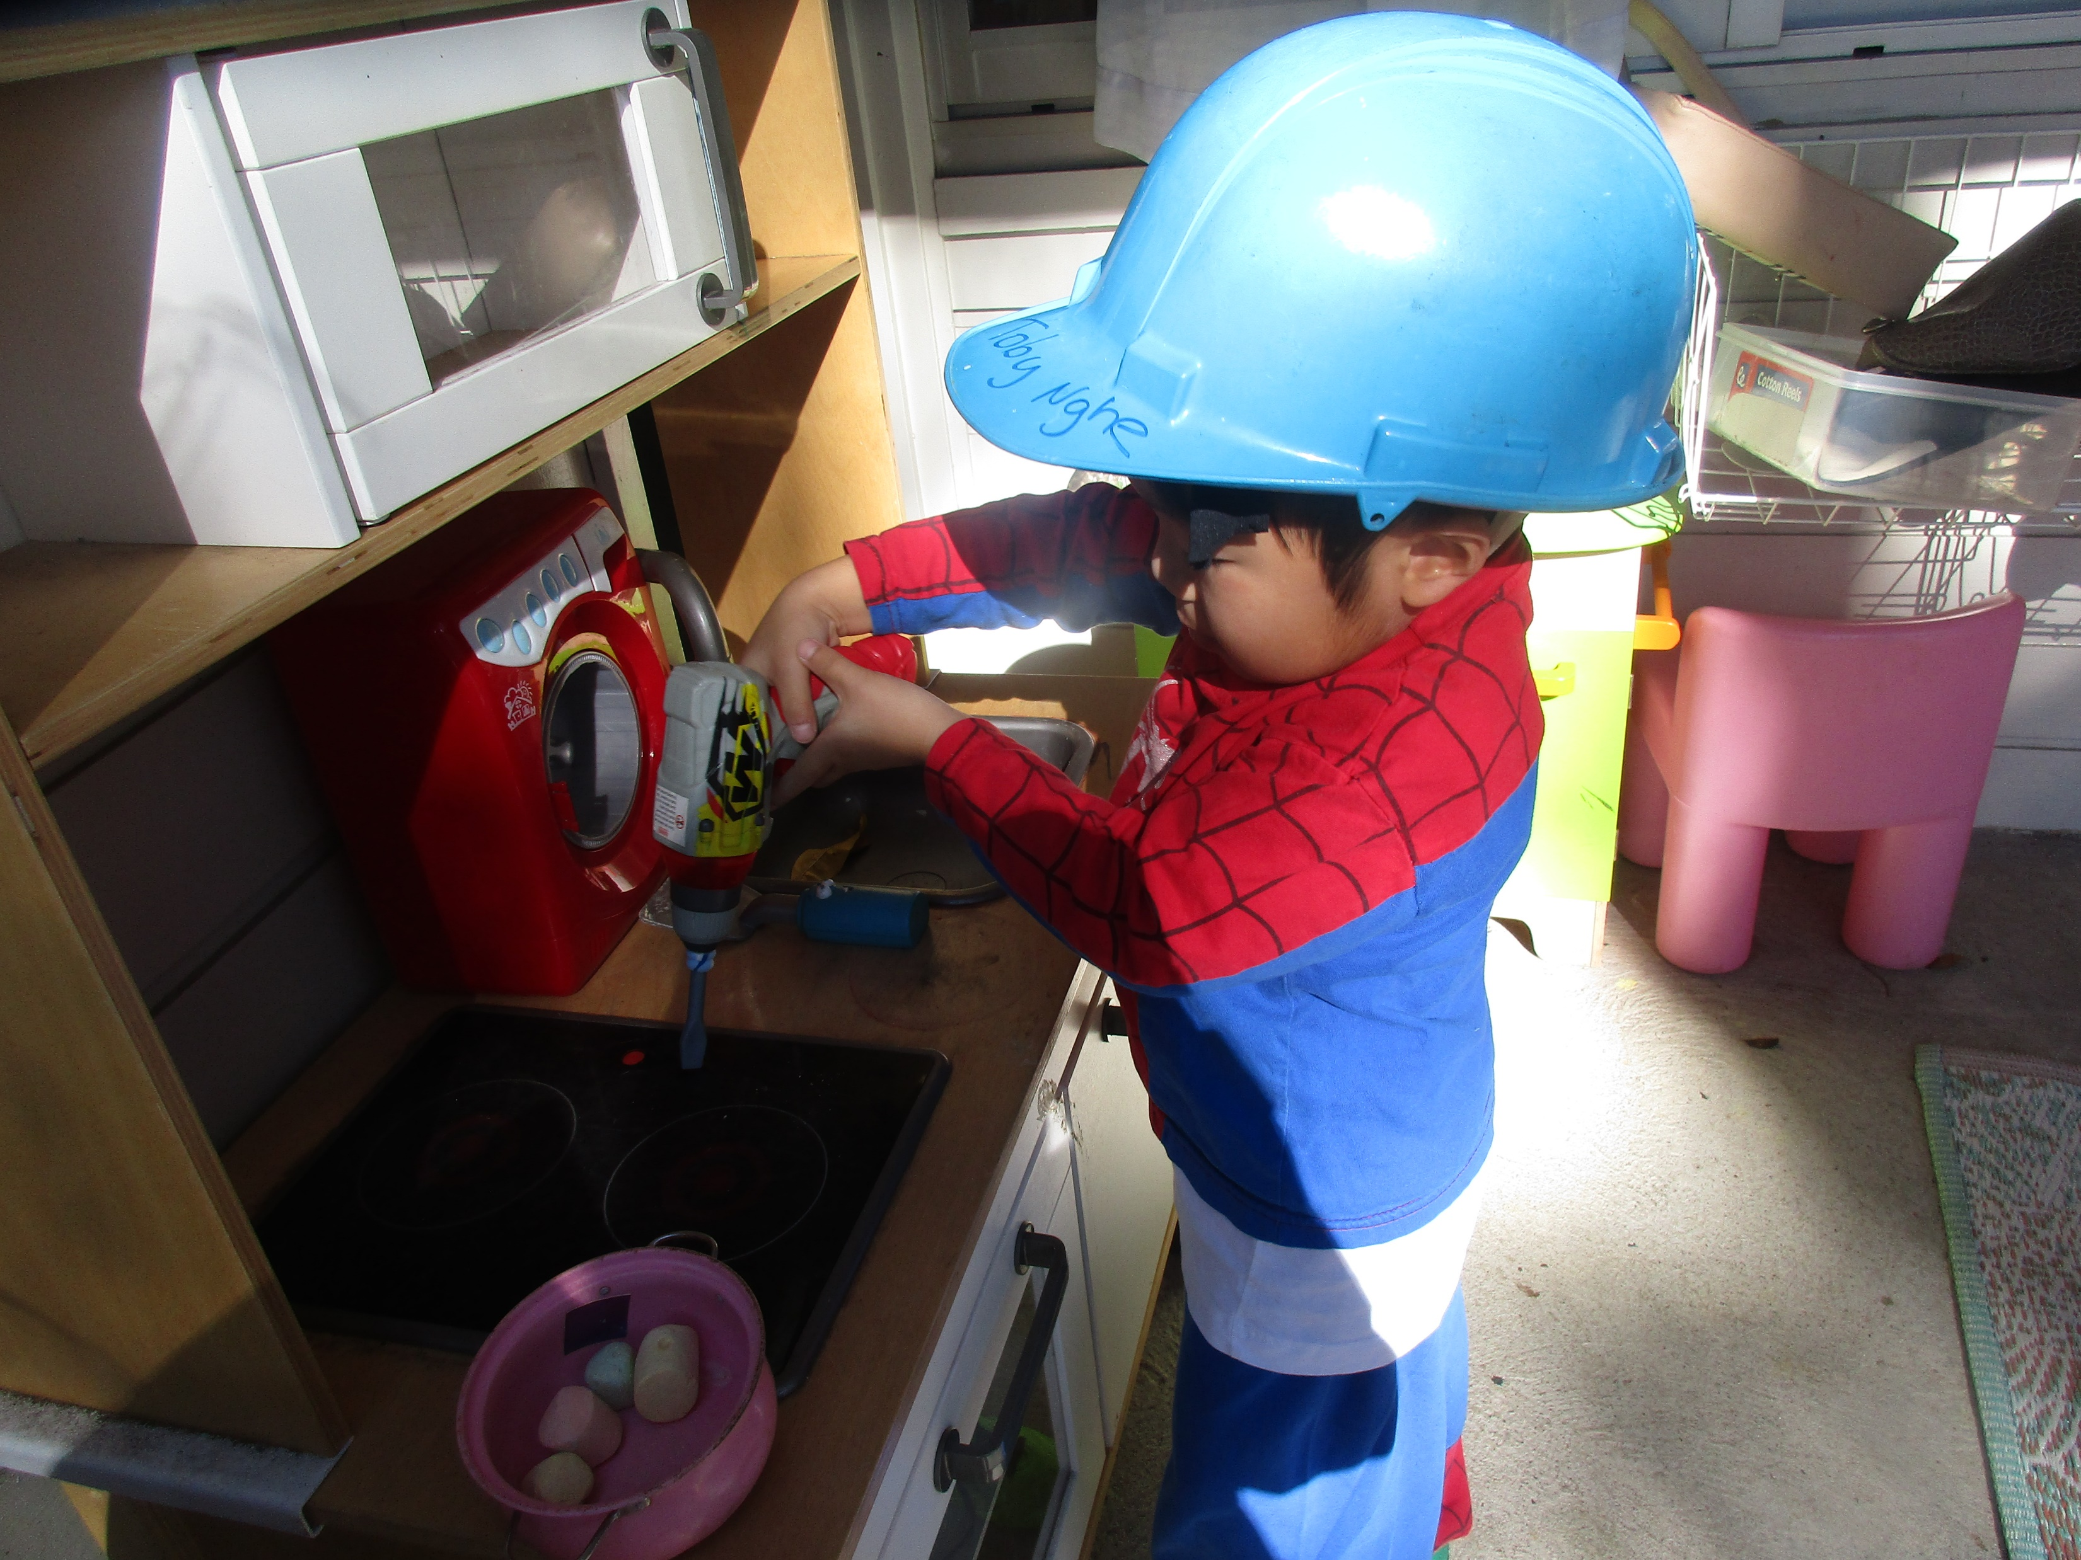
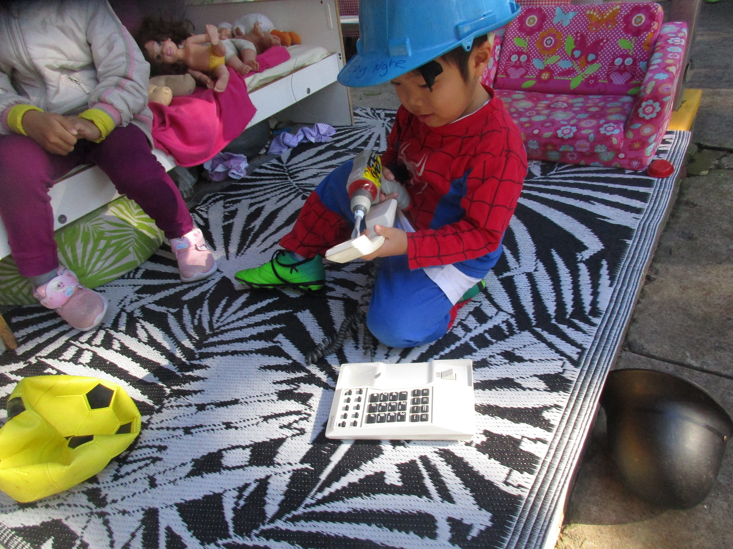
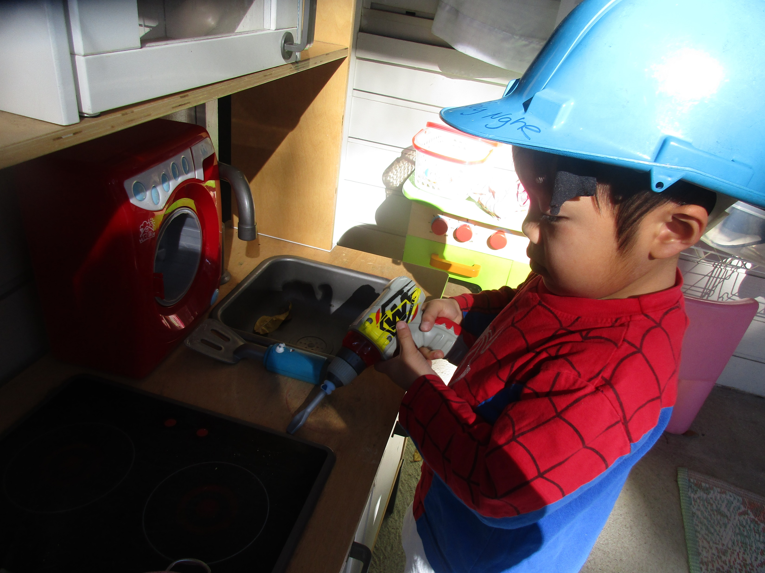
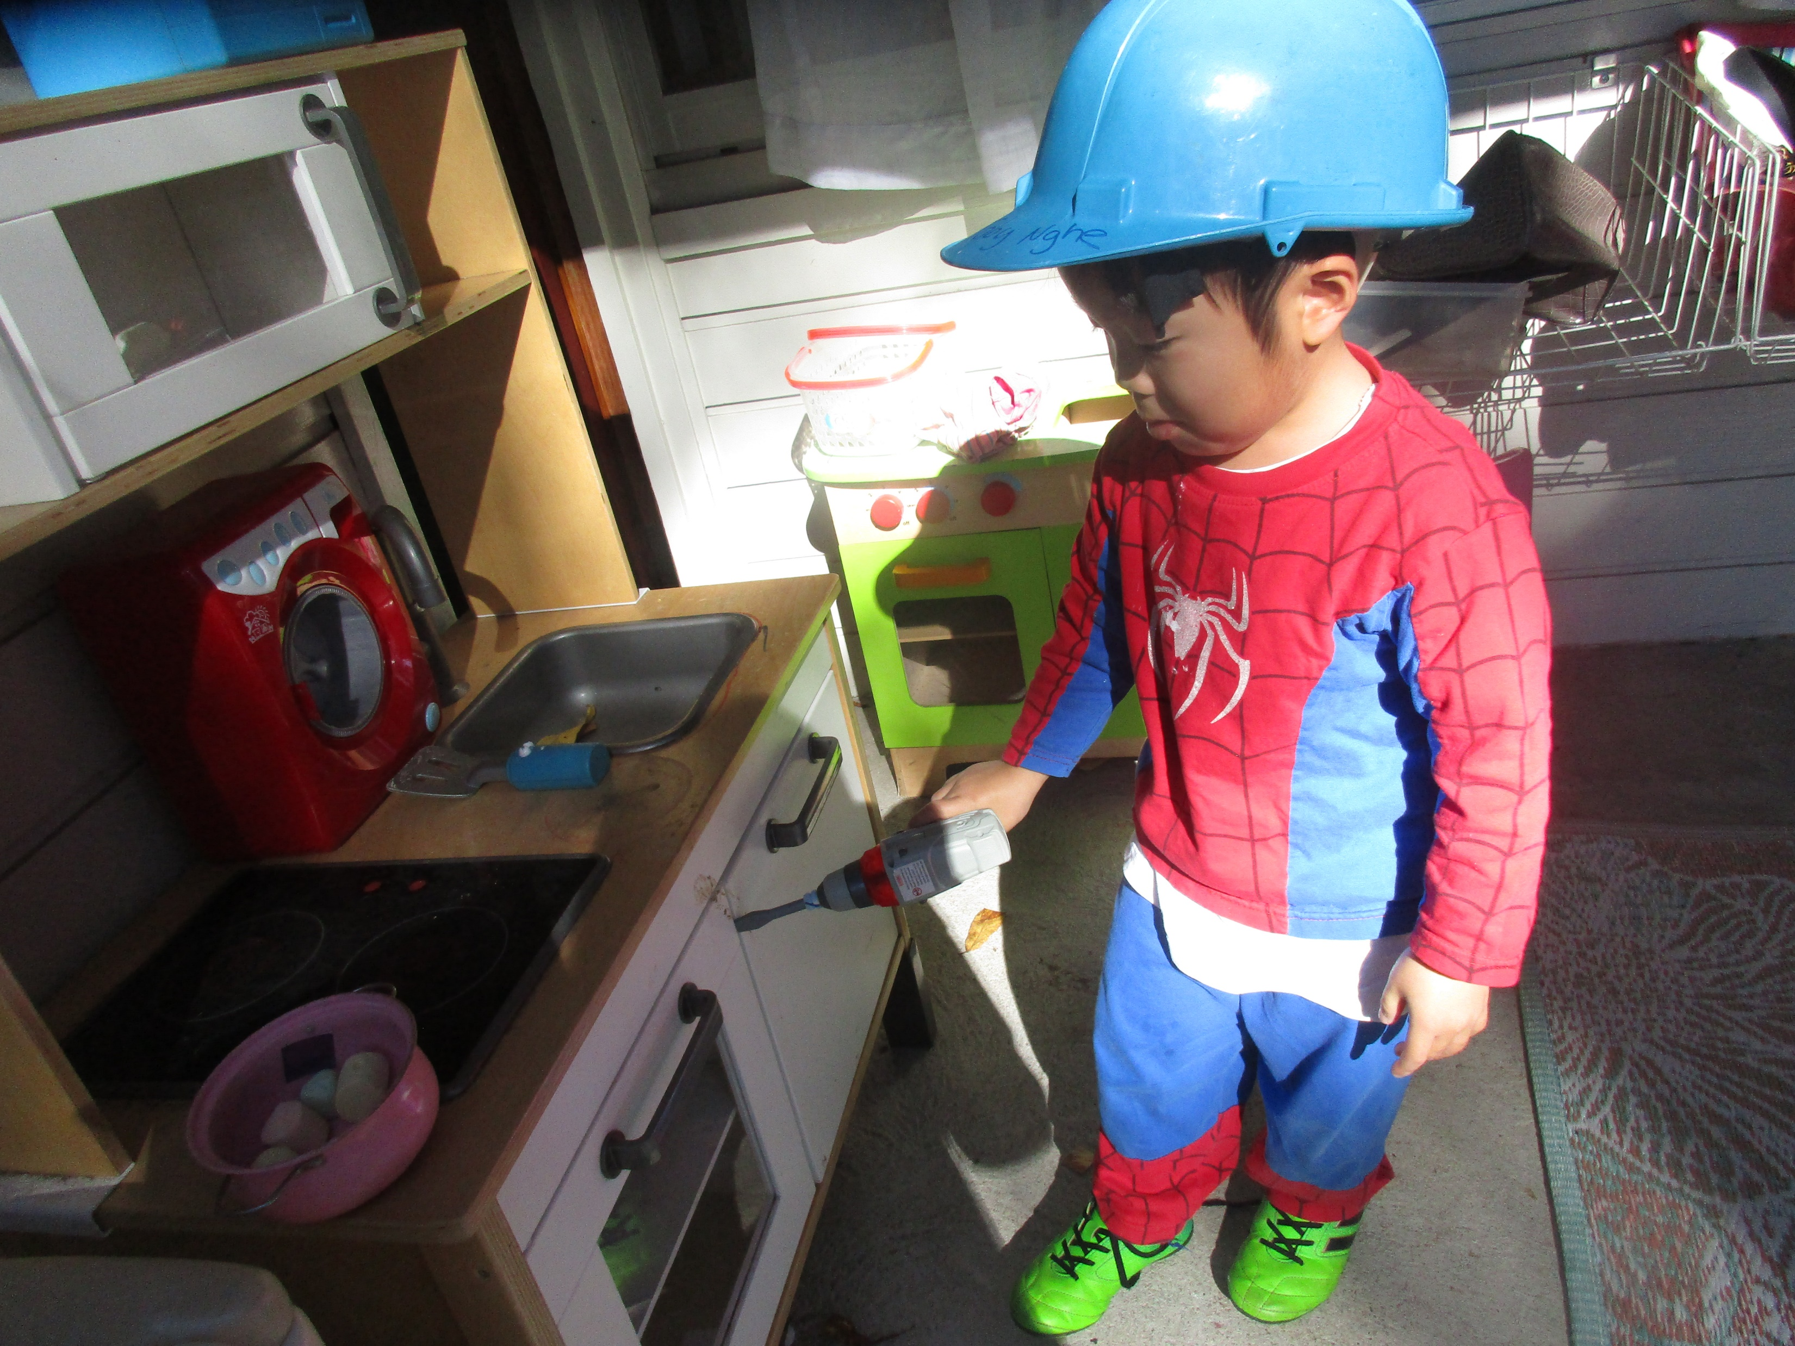
Toby, our handy man!
Toby, I love that you come to preschool dressed up in your superhero costumes. It shows me that you’re imaginative and ready to take on a role that transforms you from ordinary to extraordinary. I notice today, you had your hard hat on, a slight change from your superhero theme. You explained that you were a construction worker, then disappeared and turned up again with a drill in your hand! Where did that come from! Playing along, I asked if you could show me how good you were at fixing things with your drill. That’s when you took off, grabbing Aida’s phone and fixing it, you were so much more efficient than Telstra, getting it done within seconds. You then took off again fixing our stove, microwave and kitchen cabinets.

Slide 2
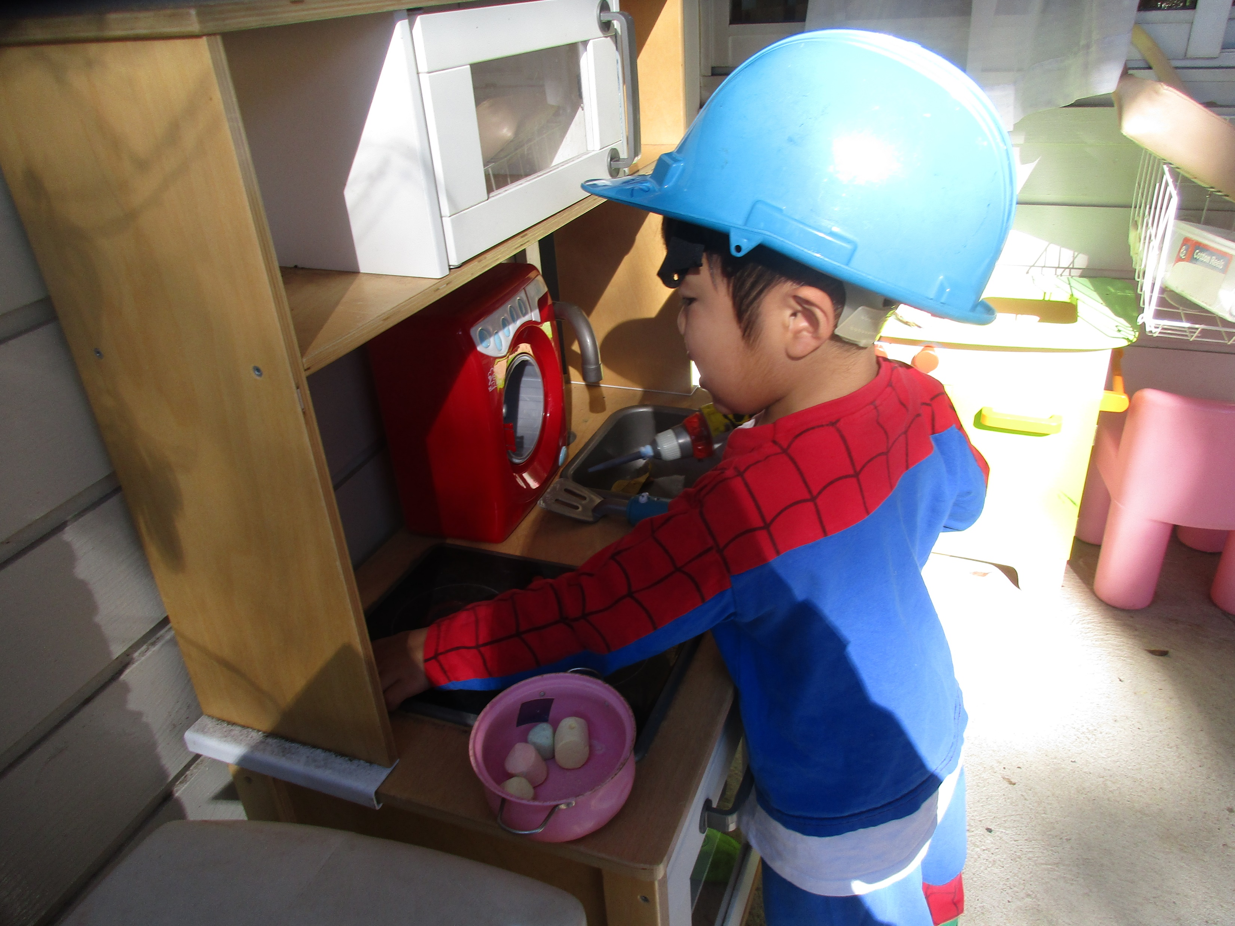
Analysis of the learning
Toby, if I could bottle up all the enthusiasm, imagination and carefree joy of just being Toby at this point in life, I absolutely would. Early childhood is a magical time in life where imagination and creativity take flight without the barriers and stresses of formal schooling. I truly hope you don’t lose this side to you and that it will continue to flourish throughout your school years. You are such a self assured and confident little boy. You did not speak to anyone during your play and you didn’t need to, so engrossed were you in your world, you had enough confidence to go about your imaginative play, not caring who saw you or who was in your way.
What next?
Since you are always in a costume playing some kind of character, how would you like to make a movie with the Ipads. Being so imaginative, I think you would make a good director and actor. Let’s give it a go, it going to be lots of fun!
Written by Ms Lien Chai 25/05/2017

